Slide 1
Wrap-up module 2 & 3 Intro to module 4 & 5
27 Nov 2023

Slide 2
Quiz questions
What is the difference between a mediating and independent variable?
A mediating variable impacts the variable of interest, an independent variable does not
An independent variable is exogenous, a mediating variable is not
An independent variable is an experimental condition, a mediating variable a disturbing effect

Slide 3
Quiz questions
What is the difference between a mediating and independent variable?
A mediating variable impacts the variable of interest, an independent variable does not
An independent variable is exogenous, a mediating variable is not
An independent variable is an experimental condition, a mediating variable a disturbing effect
A: Yes, mediating variables affect dependent variable, but independent variable can do that too!
B: Correct! (Exogonous = not affected by any other variable in the model)
C: Independent variables could be experimental conditions. But disturbing effects are typically exogonous

Slide 4
Quiz questions
A statement describing the relation between an independent and dependent variable is a
Null hypothesis
Alternate hypothesis

Slide 5
Quiz questions
What is a unit of analysis?
The discrete social unit on which data is being collected
The discrete social unit that is subject of the conceptual model
The discrete social unit that represents the independent variable

Slide 6
Quiz questions
What is a unit of analysis?
The discrete social unit on which data is being collected
The discrete social unit that is subject of the conceptual model
The discrete social unit that represents the independent variable
A: Is the definition of unit of observation
B: Correct: Unit of analysis is the social unit that the RQ / conceptual model is about
C: Incorrect: An independent variable is the property of a discrete social unit (e.g. performance of company), not the unit itself (e.g. company)

Slide 7
Quiz questions
What is NOT a condition for causality?
The independent variable (IV) and dependent variable (DV) should co-vary
The IV should precede the DV
No other (confounding) factor should cause a change in the DV
The relation between IV and DV should derive from a logical explanation (theory)
All the above are conditions for causality

Slide 8
Quiz questions
A supervisor asks a student whether his case study findings will also hold in other industries. This question relates to the study’s
Internal validity
External validity
Cross-sectional nature
Experimental design

Slide 9
Quiz questions
Which statement is correct? I: A strength of surveys is their high external validity II: All things being equal, longitudinal studies have a higher internal validity than cross-sectional studies
Only statement I is correct
Only statement II is correct
Both statements are correct
None of the statements are correct

Slide 10
Feedback weekly assignment

Slide 11
Constructs – re-occurring mistakes
1) Constructs defined as abstract phenomena that cannot be operationalized
reasons not to participate in the platform-to-platform openness
digital platform business model
prerequisites for a company to be successful
Variables that can be directly observed
Or parts from the theory
2) The construct is defined circularly to some extent
- Customer trust: Amount of faith a customer has in the platform that has access to its data
- Motivation to share data: A business’ willingness to openly share data on the platform
3) Many dependent variables are missing as a construct

Slide 12
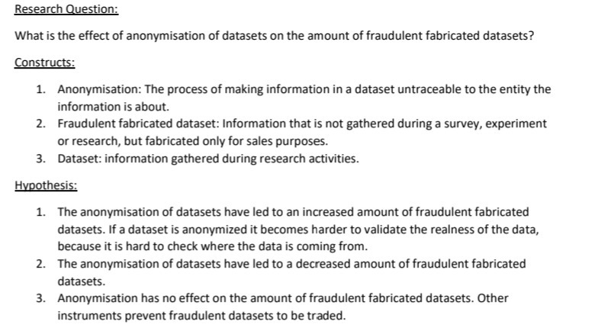
Tip - Constructs
Constructs presented are objects and processes, not concepts as intended (“security”, “privacy”, “trust”)

Slide 13
Unit of analysis
1) The unit of analysis is the major entity being studied
For instance: Organization, consumer, team, industry
So it is not
Practices used by companies to optimize the data validity
Customer trust as well as confidence and comfort with which the customer shares its data with a platform
The Business Model of Data Platforms

Slide 14
Hypothesis – frequent mistakes
1) Constructs are not connected; cannot answer the main research question
2) A technology is in the hypotheses
- The risk mapping tool positively moderates the relation between the assessment of risks and the openness on business data
→ Only put constructs = property of a unit of analysis

Slide 15
Hypothesis
Hypothesis is always the basis of your research!
Good practice:
Directional:
The success of printed products (number of sales) will be higher when customer satisfaction is higher.
Introduction of green hydrogen in the transportation sector has a positive impact on reducing GHG.
Non-directional:
Perception of the ease of use of the electric vehicles among users has an impact on their perception on the e-mobility in general.

Slide 16
Internal validity (many problems with this)
1) Criteria should be discussed rather than only mentioned
- the experience to share data and the openness of data should co-vary
2) Relate the internal validity discussion to the chosen research strategy, criteria differ per research strategy, also explain how you want to guarantee internal validity

Slide 17
Unit of analysis and research strategy
Unit of analysis:
Should always match up with research question
If your research question is about a dryer unit than the unit of analysis is the dryer unit, not the full production process
Research strategy:
Mostly used: Case study
Make sure to have a clear explanation of why you chose your strategy.
Only stating that you should collect data is too limited
Incorporate internal validity in the explanation

Slide 18
Q&A
Notes:
Q: to construct the framework we talk about constructs instead of variables?
A: Yes

Slide 19
Intro to module 4: Measurement
Constructs
Not observable
E.g., intelligence, status, trust, reputation
operationalization
Measures
Empirical
E.g., questionnaire item
validity
reliability

Slide 20
What makes a good measure?
Validity = does it measure what is intended? | Reliability = is it consistent?
Concurrent validity Predictive validity Face validity Convergent validity Discriminant validity | Test-retest reliability Parallel-form reliability Inter-item reliability Split-half reliability
Notes:
Validity: does instrument measure what is intended?
Concurrent validity
Predictive validity
Face validity
Convergent validity
Discriminant validity
Reliability: is instrument consistent across situations and time?
Test-retest reliability
Parallel-form reliability
Inter-item reliability
Split-half reliability

Slide 21
Data collection
Primary vs secondary data
Different forms of survey
Structured vs unstructured interviews
Constructing a questionnaire

Slide 22
Intro to module 5: Sampling
Population
Selecting a sufficient number of elements from the population, so that results from analyzing the sample are generalizable to the population.
Sample

Slide 23
Forms of sampling
Probability sampling = equal chance of being chosen | Non-probability sampling = skewed samples
Simple random sampling Systematic sampling Cluster sampling Stratified sampling | Convenience sampling Judgment sampling Quota sampling
Notes:
Probability sampling = Elements in the population have a known, equal, and non-zero chance of being chosen
Simple random sampling
Systematic sampling
Cluster sampling
Stratified sampling
Non-probability sampling = skewed samples, due to self-selection, self-assessment
Convenience sampling
Judgment sampling
Quota sampling

Slide 24
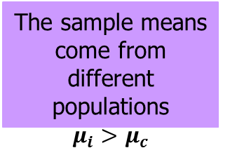
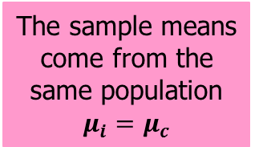
Inferential statistics
Exercise (Intervention group)
n = 36
(c)
M_{i} = 73
(e)
Population of depressed adolescents in community
Sample of participants
N = 72
(d)
or
(a)
M_{c} = 65
Non-exercise (Control group)
n = 36
(d)
(b)
(c)
(e)
Key:
(a) Selection of sample from population
(b) Assignment of participants to groups
(c) Experiment conducted
(d) Outcome of experiment
(e) Decision based on result of inferential statistic
Notes:
Suppose we are interested in the relationship between exercise and quality of life in depressed adolescents. A reasonable general hypothesis is that depressed adolescents who exercise regularly will have higher quality-of-life scores than those who do not exercise regularly. Inferential statistics provides us with a way to make a judgement about the relationship between exercise and quality of life in depressed adolescents. We start by operationalizing our variables. The independent variable, exercise, has two levels: either use of a stationary bicycle 45 minutes per day (5 days per week for 6 weeks at a workload of 50% of maximum capacity) or no prescribed exercise. The dependent variable, a quality of life inventory (QL), is an indicator of quality of life and is measured as a score between 1 and 100. To add support for our hypothesis, we could expect that 36 participants who exercise will have a higher quality-of-life index than 36 who do not exercise regularly.
This figure provides insight into the inferential process using this example. At the far left of the figure is a box representing the population. From the accessible population (depressed adolescents from the available community clinics) we sample or select, preferable randomly, 72 adolescents. This is step (a). This step is best done by selecting names from a total list of accessible depressed adolescents in such a way that all available depressed outpatients have an equal chance of being selected to be in our study (random selection). However, frequently the sample is one of convenience, not randomly selected. In the next step b, we assign participants to groups. We assign 36 patients to be in the exercise (intervention) group and 36 patients to be in the nonexercise (control) group. Again, it is best to use randomization, in this case random assignment, which implies each patient has an equal chance to be in either group. Moving to the next step c is to conduct the study. The intervention group (exercise using stationary bikes 45 minutes per day, 5 days per week, for 6 weeks) and control group (no exercise, continue their usually daily activities for the next 6 weeks). After 6 weeks, we ask the participants to complete the Quality of Life inventory (step d); the QL scores are dependent variable. Assume that we find the mean of the QL scores of the intervention group is 73 and the mean of the control group is 65. Then the mean of the intervention group is higher, seeming to support our hypothesis that exercise increases quality of life for depressed patients. From these results, can we reject our null hypothesis (that there is no difference between the exercise and no exercise conditions) and support the alternative hypothesis (that the exercise condition will increase quality of life)? Before we make this decision, we need to perform a proper statistical test (a t test for independent samples for this example).

Slide 25
Tomorrow’s lecture
Practice with the materials of module 3.a and 3.b.
Preparation needed!
Watch the learning videos from module 3.a and 3.b
Read chapters 7, 9, 12, 13 from S&B

